Slide 1
DSP Problems in Chapter 7

Slide 2
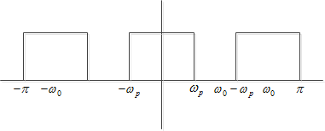
7.4 Solution

Slide 3
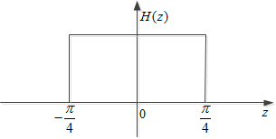
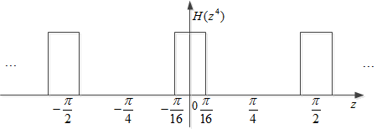
7.10 Solution
(a)

Slide 4
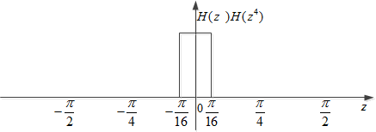
7.10 Solution
(b)

Slide 5
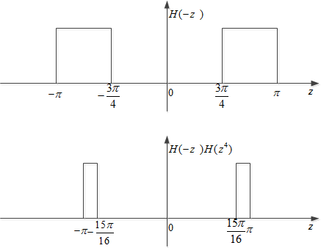
7.10 Solution
(c)

Slide 6
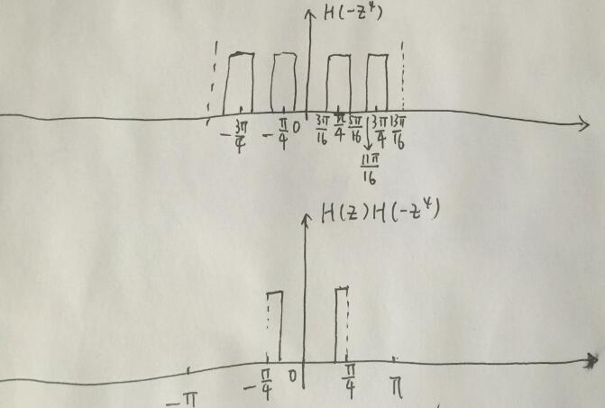
7.10 Solution
(d)

Slide 7
7.21 Solution

Slide 8
7.28 Solution
We can know that:
(i)(ii)(iii): mix-phase
(iv): maximum-phase
(v): minimum-phase
(a) Based on the symmetry of coefficients, (i) is linear-phase.
(b) (iv) have a maximum-phase response.
(c) (v) have a minimum-phase response.

Slide 9
7.41 Solution
(a) For type 3 real-coefficient FIR filter .
We can get :
(b)

Slide 10
7.43 Solution
If H(z) is a real-coefficient FIR transfer function.
are the zeros of H(z)
If , then there is a zero with
For , becomes poles of G(z).
So if , then
G(z) is not stable

Slide 11
7.60 Solution
(a)
(b)

Slide 12
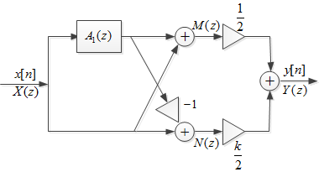
7.69 Solution
(a)

Slide 13
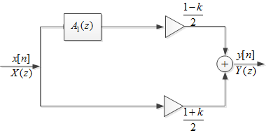
7.69 Solution
(b)

